Slide 1
Linux Processes

Slide 2
Agenda
Linux Process Overview
Process States
Process IDs
Viewing Active Processes
Killing a Process
Creating Processes
Process Scheduling
Process Controlling with Signals
Common Uses of Signals
Process Termination

Slide 3
Linux Process Overview 1/2
Linux is a multitasking system
Multiple programs can be executed at the same time
Ultimately, a program needs to be executed by a CPU
If there is only one CPU, how multiple programs can be executed at the same time?
By time sharing
That is, all programs are claimed to be executing. In fact, most of them are waiting for the CPU

Slide 4
Linux Process Overview 2/2
A process is:
A program that is claimed to be executing OR
A running instance of a program
For a multitasking system, a process has below states
Stopped
Signal
Signal
Ready
Preempt
Zombie
Running
Schedule
Terminate
I/O Done
Sleeping
I/O

Slide 5
Process States 1/3
Ready state
All processes that are ready to execute but without the CPU are at the ready state
If there is only 1 CPU in the system, all processes except one are at the ready state
Running state
The process that actually possesses the CPU is at the running state
If there is only 1 CPU in the system, at most there is only one process is at the running state
Sleeping state
The process that is waiting for other resources, e.g. I/O, is at the sleeping state
A zombie process is a process that has terminated but has not been cleaned up yet

Slide 6
Process States 2/3
Processes will alternatively get into the CPU one after the other (called the round robin scheme)
A process will be “in” a CPU for a very short time (quantum)
For Linux, each quantum is about 100msec
At the time that a process is selected to be “in” the CPU
It goes from ready state to running state
After that, it will be swapped out
It goes from running state back to ready state
Or it may due to the waiting of an I/O device, e.g. mouse
It goes from running state to sleeping state
When obtaining the required resource
It goes from sleeping state to ready state

Slide 7
Process States 3/3

Slide 8
Process IDs
Identifies uniquely process in a Linux system
A 16-bit number that are assigned sequentially by Linux as new processes are created
Every process also has a parent process (except the special init process), identified by ppid
C program to print the Process ID: print-pid.c
#include <stdio.h>
#include <unistd.h>
int main ()
{
printf (“The process ID is %d\n”, (int) getpid ());
printf (“The parent process ID is %d\n”, (int) getppid ());
return 0;
}

Slide 9
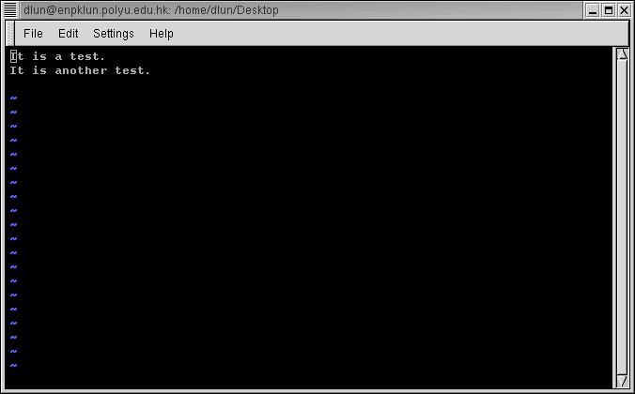
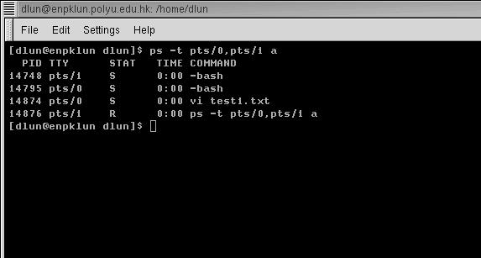
Viewing Active Processes 1/3
Terminal pts/0 has the editor vi running
Terminal pts/1 is executing ps to see the processes of both terminals
The processes of a system can be seen by using the command
ps

Slide 10
Viewing Active Processes 2/3
PID TTY STAT TIME COMMAND
14748 pts/1 S 0:00 –bash
pts/0 S 0:00 –bash
14974 pts/0 S 0:00 vi test1.txt
14876 pts/1 R 0:00 ps …
How much time the process is continuously executing
Process ID
State:
S – Sleeping
(waiting for input)
R – Running
Terminal name

Slide 11
Viewing Active Processes 3/3
For the example above, both bash processes, which are the shell of both terminals, are waiting for the input of user. They must be in the sleeping state
The vi process, which is an editor, is also waiting for the input of user. Hence it is also in sleeping state
When ps reporting the processes in the system, it is the only process that is running. Hence it is in running state

Slide 12
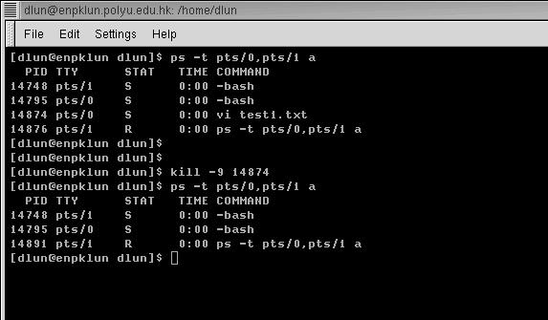
Killing a Process
A process can be forced to terminate by using the command kill -9 PID
The vi process is terminated by using the command
kill -9 14874

Slide 13
Creating Processes Using system Call
Execute a command from within a program, much as if the command had been typed into a shell.
If the shell itself cannot be run, system returns 127; if another error occurs, system returns –1
Issues: depending on the features, limitations, and security flaws of the system’s shell
#include <stdlib.h>
int main ()
{
int return_value;
return_value = system (“ls -l /”);
return return_value;
}

Slide 14
Creating Processes Using fork & exec 1/3
Using fork to Duplicate a Program’s Process: fork.c
#include <stdio.h>
#include <sys/types.h>
#include <unistd.h>
int main ()
{
pid_t child_pid;
printf (“the main program process ID is %d\n”, (int) getpid ());
child_pid = fork ();
if (child_pid != 0) {
printf (“this is the parent process, with id %d\n”, (int) getpid ());
printf (“the child’s process ID is %d\n”, (int) child_pid);
}
else
printf (“this is the child process, with id %d\n”, (int) getpid ());
return 0;
}

Slide 15
Creating Processes Using fork & exec 2/3
The exec functions replace the program running in a process with another program (fork-exec.c)
#include <stdio.h>
#include <stdlib.h>
#include <sys/types.h>
#include <unistd.h>
int spawn (char* program, char** arg_list) {
pid_t child_pid;
child_pid = fork (); //Duplicate this process
if (child_pid != 0) //This is the parent process
return child_pid;
else {//Now execute PROGRAM, searching for it in the path
execvp (program, arg_list);
//The execvp function returns only if an error occurs.
fprintf (stderr, “an error occurred in execvp\n”);
abort ();
}
}

Slide 16
Creating Processes Using fork & exec 3/3
int main ()
{
//The argument list to pass to the “ls” command.
char* arg_list[] = {
“ls”, // argv[0], the name of the program.
“-l”,
“/”,
NULL //The argument list must end with a NULL.
};
/* Spawn a child process running the “ls” command. Ignore the
returned child process ID. */
spawn (“ls”, arg_list);
printf (“done with main program\n”);
return 0;
}

Slide 17
Process Scheduling 1/3
The mechanism to determine which process should “get into” the CPU is called Process scheduling
For example,
Actual sequence of operations
Program A

Slide 18
Process Scheduling 2/3
Actual sequence of operations
Program B

Slide 19
Process Scheduling 3/3
Program A and B will be at the running state alternatively, depends on the quantum size and the availability of the required resource
Program A finishes
Quantum end
Waiting for user input
Quantum end
Program B finishes
Waiting for user input

Slide 20
Process Controlling with Signals Signal Overview
Mechanisms for communicating with and manipulating processes in Linux (whereby processes are made aware of events occurring)
A special message sent to a process, as an asynchronous event.
May be unrelated to the execution of a process, can be received by the process at any time in its execution
E.g. user types ctrl-C, or the modem hangs
The process handles the received signal immediately without finishing the current function or even the current line of code

Slide 21
Process Controlling with Signals Signal Types & Sources
terminal driver
memory management
shell command
SIGINT
SIGHUP
SIGQUIT
SIGKILL
kernel
SIGPIPE
SIGWINCH
SIGALRM
window manager
a process
SIGUSR1
other user processes

Slide 22
Process Controlling with Signals Signal Types & Sources: Examples
Name Description
SIGINT Interrupt character typed
SIGFPE Floating point exception SIGKILL Terminate receiving process (kill –9)
SIGPIPE child process stopped or terminated SIGALRM alarm() clock ‘rings’
SIGSEGV Segmentation (segment access) violation SIGUSR1 user-defined signal type SIGUSR2 user-defined signal type

Slide 23
Process Controlling with Signals Generating a Signal
Use the UNIX command:
$ kill -KILL 4481
send a SIGKILL signal to pid 4481
check
ps –l
to make sure process died
kill is not a good name; send_signal might be better.

Slide 24
Process Controlling with Signals Generating a Signal: kill()
Send a signal to a process (or group of processes).
#include <signal.h> int kill( pid_t pid, int signo );
Return 0 if ok, -1 on error.

Slide 25
Process Controlling with Signals Some pid Values
pid Meaning > 0 send signal to process pid == 0 send signal to all processes whose process group ID equals the sender’s pgid. e.g. parent kills all children

Slide 26
Process Controlling with Signals Responding to a Signal
Default action is usually for kernel to terminate the receiving process.
Process can request some other action :
Ignore/discard the signal: process will not know it happened (not possible with SIGKILL or SIGSTOP)
Restore signal’s default action
Execute a pre-arranged signal-handling function, and then possibly resume execution or terminate
Process can register a function to be called
Like an interrupt service routine
When the handler returns, control is passed back to the main process code and normal execution continues
The choice is called the process’ signal disposition

Slide 27
Process Controlling with Signals Signal Handling
The signal function itself
returns a pointer to a function.
The return type is the same
as the function that is passed in,
i.e., a function that takes an
int and returns a void
The signal to be
caught or ignored
is given as argument
sig
The handler function
Receives a single integer
Argument and returns void
Use the signal handling library: signal.h
Then can use the signal call:
#include <signal.h>
void (*signal( int sig, void (*handler)(int))) (int) ;
signal returns a pointer to the PREVIOUS signal handler
#include <signal.h>
typedef void Sigfunc(int); /* my defn */
Sigfunc *signal( int signo, Sigfunc *handler );
The function to be called
when the specified signal
is received is given as a
pointer to the function
handler
Signal is a function
that takes two
arguments:
sig and handler
The returned function
takes a integer
parameter.
Notes:
to set up a signal handler:
#include <signal.h> #include <unistd.h> void (*signal(int signum, void (*handler)(int)))(int);
signal is a call which takes two parameters
signum : the signal number
handler : a pointer to a function which takes a single integer parameter and returns nothing (void)
return value is itself a pointer to a function which:
takes a single integer parameter and returns nothing

Slide 28
Process Controlling with Signals Signal Handling Example 1/4
int main() { signal( SIGINT, foo ); :
/* do usual things until SIGINT */
return 0; } void foo( int signo ) { : /* deal with SIGINT signal */
return; /* return to program */ }

Slide 29
Process Controlling with Signals Signal Handling Example 2/4
//File name: sig_examp.c
#include <stdio.h>
#include <unistd.h>
#include <signal.h>
void sig_usr( int signo ); /* handles two signals */
int main()
{
int i = 0; if( signal( SIGUSR1,sig_usr ) == SIG_ERR ) printf( “Cannot catch SIGUSR1\n” ); if( signal( SIGUSR2,sig_usr ) == SIG_ERR ) printf(“Cannot catch SIGUSR2\n”); :
continued

Slide 30
Process Controlling with Signals Signal Handling Example 3/4
: while(1) { printf( “%2d\n“, I ); pause(); /* pause until signal handler has processed
signal */ i++; } return 0; }
continued

Slide 31
Process Controlling with Signals Signal Handling Example 4/4
void sig_usr( int signo ) /* argument is signal number */ { if( signo == SIGUSR1 ) printf(“Received SIGUSR1\n”); else if( signo == SIGUSR2 ) printf(“Received SIGUSR2\n”); else printf(“Error: received signal %d\n”, signo); return; }

Slide 32
Process Controlling with Signals Signal Handling Example: Usage
$ sig_examp & [1] 4720 0 $ kill -USR1 4720 Received SIGUSR1 1 $ kill -USR2 4720 Received SIGUSR2 2 $ kill 4720 /* send SIGTERM */ [1] + Terminated sig_examp & $

Slide 33
Process Controlling with Signals Special Sigfunc * Values
Value Meaning SIG_IGN Ignore / discard the signal. SIG_DFL Use default action to handle signal. SIG_ERR Returned by signal() as an error.

Slide 34
Process Controlling with Signals Multiple Signals
If many signals of the same type are waiting to be handled (e.g. two SIGINTs), then most UNIXs will only deliver one of them.
the others are thrown away
If many signals of different types are waiting to be handled (e.g. a SIGINT, SIGSEGV, SIGUSR1), they are not delivered in any fixed order.

Slide 35
Process Controlling with Signals pause()
Suspend the calling process until a signal is caught.
#include <unistd.h> int pause(void);
Returns -1 with errno assigned EINTR. (Linux assigns it ERESTARTNOHAND).
pause() only returns after a signal handler has returned.

Slide 36
Process Controlling with Signals The Reset Problem
In Linux (and many other UNIXs), the signal disposition in a process is reset to its default action immediately after the signal has been delivered.
Must call signal() again to reinstall the signal handler function.

Slide 37
Process Controlling with Signals Reset Problem Example
int main() { signal(SIGINT, foo); : /* do usual things until SIGINT */ } void foo(int signo) { signal(SIGINT, foo); /* reinstall */ : return; }

Slide 38
Process Controlling with Signals Reset Problem
To keep catching
the signal with this
function, must call
the signal system
call again.
:
void ouch( int sig )
{
printf( "OUCH! - I got signal %d\n", sig );
(void) signal(SIGINT, ouch);
}
int main()
{
(void) signal( SIGINT, ouch );
while(1)
{
printf("Hello World!\n");
sleep(1);
}
}
Problem: from the time
that the interrupt function
starts to just before the
signal handler is re-established
the signal will not be
handled.
If another SIGINT signal is
received during this time,
default behavior will be done,
i.e., program will terminate.

Slide 39
Common Uses of Signals
Ignore a Signal
Clean up and Terminate
Dynamic Reconfiguration
Report Status
Turn Debugging on/off
Restore Previous Handler

Slide 40
Common Uses of Signals Ignore a Signal
: int main() { signal(SIGINT, SIG_IGN); signal(SIGQUIT, SIG_IGN); : /* do work without interruptions */ }
Cannot ignore/handle SIGKILL or SIGSTOP
Should check for SIG_ERR

Slide 41
Common Uses of Signals Clean up & Terminate 1/2
: /* global variables */ int my_children_pids; : void clean_up(int signo); int main() { signal(SIGINT, clean_up); : }
continued

Slide 42
Common Uses of Signals Clean up & Terminate 2/2
void clean_up(int signo) { unlink(“/tmp/work-file”); kill(my_children_pids, SIGTERM); wait((int *)0); fprintf(stderr, “Program terminated\n”); exit(1); }

Slide 43
Common Uses of Signals Clean up &Terminate: Problems
If a program is run in the background then the interrupt and quit signals (SIGINT, SIGQUIT) are automatically ignored.
Your code should not override these changes:
check if the signal dispositions are SIG_IGN

Slide 44
Common Uses of Signals CleanUp&Terminate: Disposition Checking
new disposition
old disposition
: if( signal(SIGINT, SIG_IGN ) != SIG_IGN ) signal(SIGINT, clean_up); if( signal(SIGQUIT, SIG_IGN ) != SIG_IGN ) signal(SIGQUIT, clean_up); :
Note: cannot check the signal disposition without changing it (sigaction that we will look at later , is different)

Slide 45
Common Uses of Signals Dynamic Reconfiguration 1/2
: void read_config(int signo); int main() { read_config(0); /* dummy argument */ while (1) /* work forever */ }
continued

Slide 46
Common Uses of Signals Dynamic Reconfiguration 2/2
void read_config(int signo) { int fd; signal( SIGHUP, read_config ); fd = open(“config_file”, O_RDONLY); /* read file and set global vars */ close(fd); return; }

Slide 47
Common Uses of Signals Dynamic Reconfiguration: Problems
Reset problem
Handler interruption
what is the effect of a SIGHUP in the middle of read_config()’s execution?
Can only affect global variables.

Slide 48
Common Uses of Signals Report Status 1/2
: void print_status(int signo); int count; /* global */ int main() { signal(SIGUSR1, print_status); : for( count=0; count < BIG_NUM; count++ )
{ /* read block from tape */ /* write block to disk */ } ... }
continued

Slide 49
Common Uses of Signals Report Status 2/2
void print_status(int signo) { signal(SIGUSR1, print_status); printf(“%d blocks copied\n”, count); return; }
Reset problem
count value not always defined.
Must use global variables for status information

Slide 50
Common Uses of Signals Turn Debugging on/off 1/2
: void toggle_debug(int signo); int debug = 0; /* initialize here */ int main() { signal(SIGUSR2, toggle_debug); /* do work */ if (debug == 1)
printf(“...”); ... }
continued

Slide 51
Common Uses of Signals Turn Debugging on/off 2/2
void toggle_debug(int signo) { signal(SIGUSR2, toggle_debug); debug = ((debug == 1) ? 0 : 1); return; }

Slide 52
Common Uses of Signals Restore Previous Handler
: Sigfunc *old_hand; /* set action for SIGTERM; save old handler */ old_hand = signal(SIGTERM, foobar); /* do work */ /* restore old handler */ signal(SIGTERM, old_hand); :

Slide 53
Process Termination
Normally, a process terminates in one of two ways:
The executing program calls the exit function,
The program’s main function returns
A process may also terminate abnormally, in response to a signal (i.e: SIGBUS, SIGSEGV, and SIGFPE signals)
Other signals are used to terminate a process explicitly
SIGINT signal: user types Ctrl+C in its terminal.
SIGTERM signal: user types the kill command
By calling the abort function: a process sends itself the SIGABRT signal, which terminates the process & produces a core file
SIGKILL signal
Ends a process immediately & cannot be blocked/handled by a program
Raised by typing “kill -KILL pid” in the command line

Slide 54
Process Termination Waiting for Process Termination
The child process is scheduled independently of the parent process => Sometimes, the called program might complete after the “main program”.
The wait family of system calls allows the parent process to wait until one or more child processes have completed.
Waiting enables the parent process to retrieve information about its child’s termination

Slide 55
Process Termination Example
int main ()
{
int child_status;
//The argument list to pass to the “ls” command.
char* arg_list[] = {
“ls”, // argv[0], the name of the program.
“-l”, “/”,
NULL //The argument list must end with a NULL.
};
spawn (“ls”, arg_list); // Spawn a child process running the “ls” command
/* Wait for the child process to complete. */
wait (&child_status);
if (WIFEXITED (child_status))
printf (“the child process exited normally, with exit code %d\n”,
WEXITSTATUS (child_status));
else
printf (“the child process exited abnormally\n”); return 0;
}
Determine from a child process’s exit status whether that process exited normally (via the exit function or returning from main) or died from an unhandled signal
Extract from its exit status the signal number by which it died

Slide 56
Process Termination Zombie Process
A process that has terminated but has not been cleaned up yet
The parent process is responsible to clean up its zombie children
The init process automatically cleans up any zombie child processes that it inherit

Slide 57
Process Termination Example – Making a Zombie Process
//File name: zombie.c
#include <stdlib.h>
#include <sys/types.h>
#include <unistd.h>
int main () {
pid_t child_pid;
child_pid = fork (); // Create a child process.
if (child_pid > 0) {
sleep (60); // This is the parent process. Sleep for a minute.
}
else {
exit (0); // This is the child process. Exit immediately.
}
return 0;
}
Try compiling this file to an executable named make-zombie. Run it, and while it’s still running, list the processes on the system by invoking the following command in another window :
ps -e -o pid,ppid,stat,cmd

Slide 58
Q & A

